Slide 1
Draw the development of an oblique circular cylinder with base diameter 30 mm and axis inclined at 75º with the base. Height of the cylinder is 50 mm
Divide the surface of the cylinder into equal parts as shown, with the generator lines parallel to the end generators
Draw a rectangle ABCD extending in height from the top of one side of the cylinder to the opposite side on the bottom end as shown. The smaller side of the rectangle should be parallel to the end generators
φ30
G
Draw projection lines from the top edge of the cylinder such that they are perpendicular to the end generator
Mark distances AB, BC etc. from one projector line to the next to complete the profile
Do the similar process for the bottom edge
G1
A
a
F
B
E
D
C
T
F
G
A
A
B
C
50
A
G
75º
G1
A1
A1
G1
A1

Slide 2

Draw the development of the oblique cone cut by a plane as shown
Divide base and draw generators along the surface
Find true lengths of the generators and join them to the apex at one end and to the linear distance gf = fe = de etc. at the other end
o
a
b
g
o
d
c
Mark the points of intersection of the plane with the generators
b
f
f
True lengths of these generators are given for example. You have to find true lengths of all the generators
c
e
d
o
1
2
2
3
1
3
2
4
4
3
4
continue
a
a
b
c
e
f
d
g
d
c
b
b
c
d

Slide 3
Triangulation method for curved surfaces (approximate)
True lengths
d
a
o
d
b
c
c
a
b
a
b
c
d
Development
(True lengths of lines, linear distances between a-b-c-d joined by a smooth curve)
o
o
3-D view
Orthographic views

Slide 4
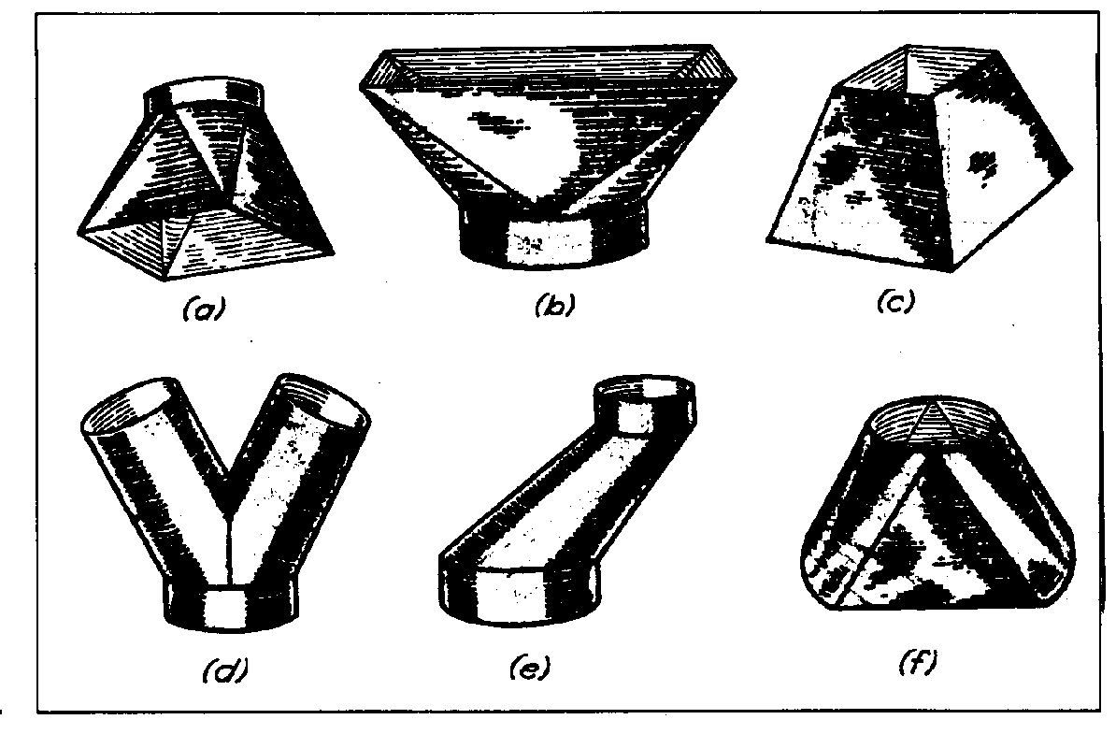
Transition pieces (transition from one cross section to another)

Slide 5
Draw the half development of the transition piece- hexagon (4 cm side) to circle (4 cm diameter)
5
8
4
j
Measure corresponding true lengths and mark them point to point in the development
k
i
l
h
l
o
8
6
a
g
3
j
b
f
i
c
e
4
d
h
1
7
2
g
1
d’
g’
a’
e”
f”
b’
c’
e’
f’
f
3
e
d
2
2e” and 2f” are true lengths of 2e and 2f respectively
7’
2’
7

Slide 6
Transition piece, hexagon to circle
Conical
Flat
Flat
Flat
Draw diameters on the circle perpendicular to the sides of the hexagon.
Join the ends of these diameters to the corresponding corners of the hexagon to segregate the flat and conical parts of the surface
Flat
Flat
Flat
Flat
Flat
Flat

Slide 7
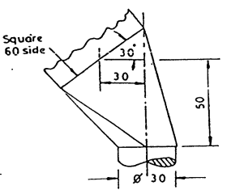
Lines joining the corners to the end of diameters form the sides of the flat faces
d
c
5
4
3
2
1
a
b
Transition piece- square at one end and circular at the other
Divide into triangles, find true lengths of sides
Join triangles in 2-D to get development
T
b
F
a
Get true length of sides a1, 1b, ab
Construct triangle a1b
Similarly construct triangle a12
adjoining triangle a23 etc.
3
2
1

Slide 8
Draw the half development of a hemispherical bowl of radius 3 cm by any method
Divide into meridian sections – Gore development
4
6
8
10
The approximate method is used
Divide the top view into sectors as shown
The lengths of one sector are required and 6 of them should be drawn adjacent to each other
Linear distances o’a’, a’b’, b’c’,…1-2, 3-4 etc. are taken
2
o
a
b
c
d
e
1
3
5
7
9
T
F
o’
a’
b’
o’
o’
o’
o’
o’
o’
c’
d’
a’
a’
a’
a’
a’
a’
1
2
3
b’
b’
b’
b’
b’
b’
4
e’
5
c’
6
c’
c’
c’
c’
c’
7
d’
8
d’
d’
d’
d’
d’
9
e’
10
e’
e’
e’
e’
e’

Slide 9
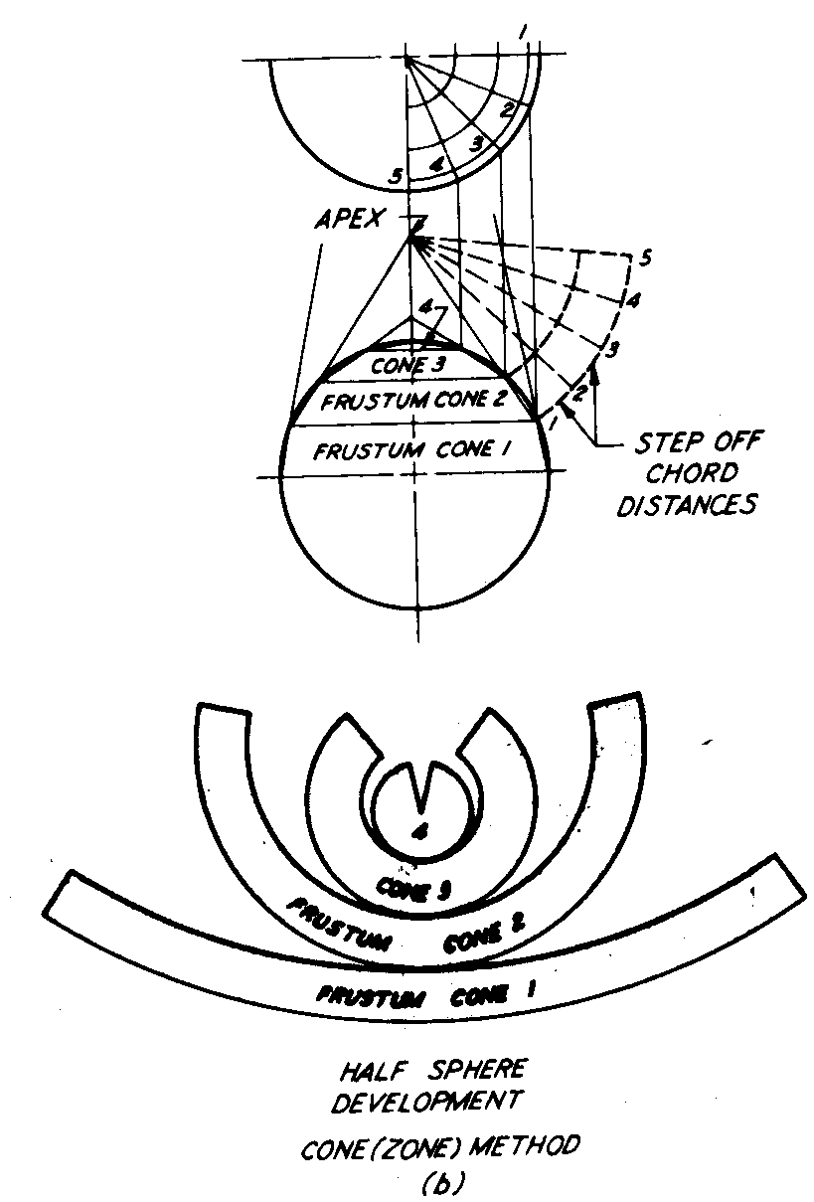
Sphere development – Cone method (Zone development)

